Slide 1
Chapter 7
FEATURE
EXTRACTION AND SELECTION
METHODS
Part 2
Cios / Pedrycz / Swiniarski / Kurgan

Slide 2
Feature Selection
GOAL
find the “best” subset of features according to a predefined selection criterion
Reasons for Feature Selection (FS)
Features can be:
– irrelevant (have no effect on processing)
– redundant (the same, correlated)
Decrease problem dimensionality
The process of FS does NOT involve transformation of the original features.
© 2007 Cios / Pedrycz / Swiniarski / Kurgan

Slide 3
Feature Selection
Feature relevancy
can be understood as its ability to contribute to improving classifier’s performance
For Boolean features:
Def1:
A feature x_{i} is relevant to class c if it appears in every Boolean formula that represents c, otherwise it is irrelevant
© 2007 Cios / Pedrycz / Swiniarski / Kurgan

Slide 4
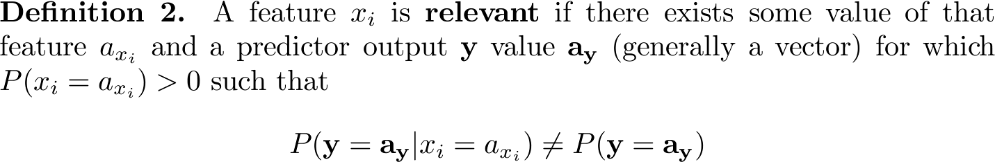
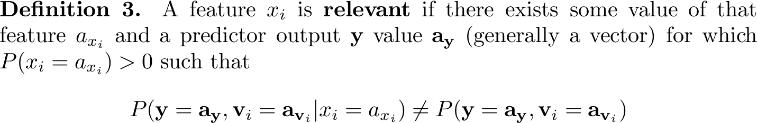
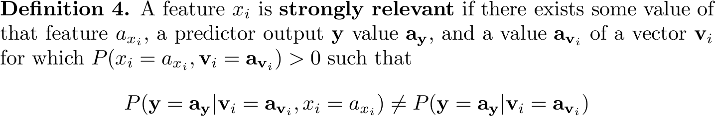
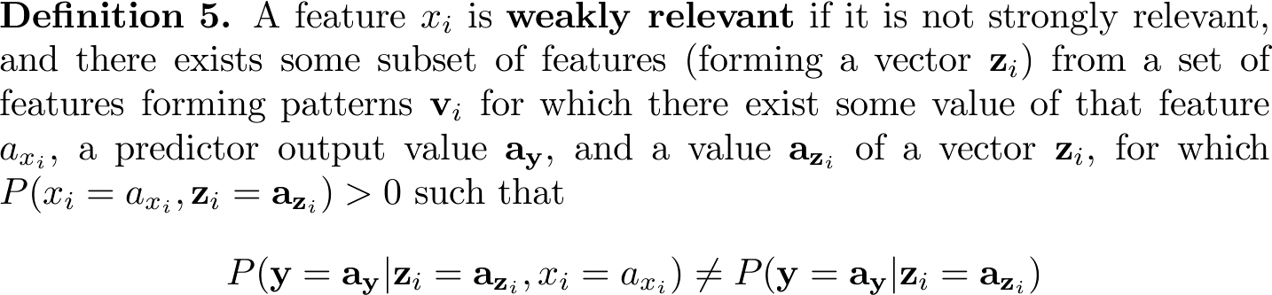
Feature Selection
© 2007 Cios / Pedrycz / Swiniarski / Kurgan

Slide 5
Feature Selection
Key feature selection methods:
- Open-loop (filter/ front-end/ preset bias)
- Closed-loop (wrapper/ performance bias)
Result: data set with reduced number of features according to a specified optimal criterion
© 2007 Cios / Pedrycz / Swiniarski / Kurgan

Slide 6
Feature Selection
Open-loop methods (FILTER, preset bias, front end):
Select features for which the reduced data set maximizes between-class separability
(by evaluating within-class and between-class covariance matrices);
no feedback mechanism from the processing algorithm.
Closed-loop methods (WRAPPER, performance bias, classifier feedback):
Select features based on the processing algorithm performance (feedback mechanism),
which serves as a criterion for feature subset selection.
© 2007 Cios / Pedrycz / Swiniarski / Kurgan

Slide 7
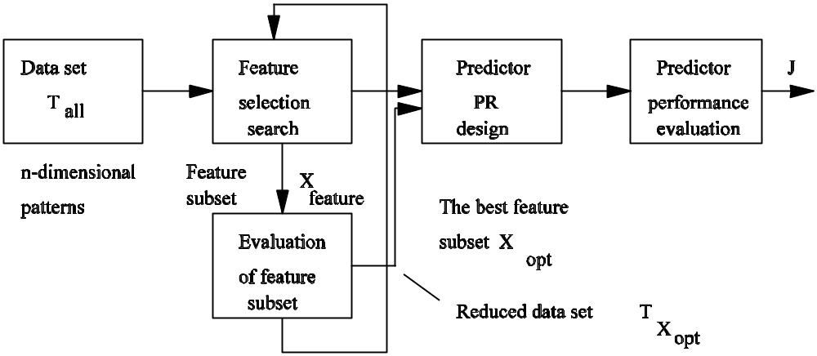
Feature Selection
An open loop feature selection method
© 2007 Cios / Pedrycz / Swiniarski / Kurgan

Slide 8
A closed-loop feature selection method
© 2007 Cios / Pedrycz / Swiniarski / Kurgan

Slide 9
Feature Selection
Procedure for optimal FS:
Search procedure, to search through candidate subsets of features
(given initial step of a search and stop criteria)
- FS criterion, J_{feature}, to judge if one subset of features is better than another
Since feature selection methods are computationally intensive we use heuristic search methods; as a result only sub-optimal solutions can be obtained.
© 2007 Cios / Pedrycz / Swiniarski / Kurgan

Slide 10
Feature Selection
FS criteria
We use criteria based on maximization, where a better subset of features always gives a bigger value of a criterion
and the optimal feature subset gives the maximum value of the criterion.
In practice:
For the limited data set and FS criterion based on a classifier performance, removing a feature may improve algorithm’s performance (up to a point as it then starts to degrade) – peaking phonomenon.
© 2007 Cios / Pedrycz / Swiniarski / Kurgan

Slide 11
Feature Selection
FS criteria
Monotonicity property
X_{f}⁺ denotes a larger feature subset that contains X_{f as a subset}
Criteria with monotonicity property are used to compare different feature subsets of equal size; it means that adding a feature to a given feature subset results in a criterion value that stays the same or increases:
J_{feature}({x₁})≤ J_{feature}({x₁,x₂})≤… ≤ J_{feature}({x₁,x₂,,…,x_{n}})
© 2007 Cios / Pedrycz / Swiniarski / Kurgan

Slide 12
Feature Selection
Paradigms of optimal FS: minimal representations
Occam’s Razor:
The simplest explanation of the observed phenomena in a given domain is the most likely to be a correct one.
Minimal Description Length (MDL) Principle:
Best feature selection can be done by choosing a minimal feature subset that fully describes all classes in a given data set.
© 2007 Cios / Pedrycz / Swiniarski / Kurgan

Slide 13
Feature Selection
MDL Principle:
can be seen as a formalization of the Occam’s razor heuristic.
In short, if a system can be defined in terms of input and the corresponding output data, then in the worst case (longest) it can be described by supplying the entire data set.
On the other hand, if regularities can be discovered, then a much shorter description is possible and can be measured by the MDL principle.
© 2007 Cios / Pedrycz / Swiniarski / Kurgan

Slide 14
Feature Selection
Criteria
A feature selection algorithm uses predefined feature selection criterion
(which measures goodness of the subset of features)
Our hope (via MDL principle) is that:
  by reducing dimensionality we improve generalization
  ability, up to some max value,
  but we know that it will start to degrade at some point
  of reduction
© 2007 Cios / Pedrycz / Swiniarski / Kurgan

Slide 15
Feature Selection
OPEN-LOOP METHODS (OLM)
Feature selection criteria based on information contained in the data set alone, can be based on:
  MDL Principle
  Mutual Information
  Inconsistency Count
  Interclass Separability
© 2007 Cios / Pedrycz / Swiniarski / Kurgan

Slide 16
Feature Selection
OLM based on the MDL Principle
Choose a minimal feature subset that fully describes all classes in a given data set.
1. For all subsets do:
J_{feature}(subset_{i}) = 1 if subset_{i} satisfactorily describes all classes in the data
= 0 otherwise
2. Choose a minimal subset for which J_{feature}(subset_{i}) = 1
© 2007 Cios / Pedrycz / Swiniarski / Kurgan

Slide 17
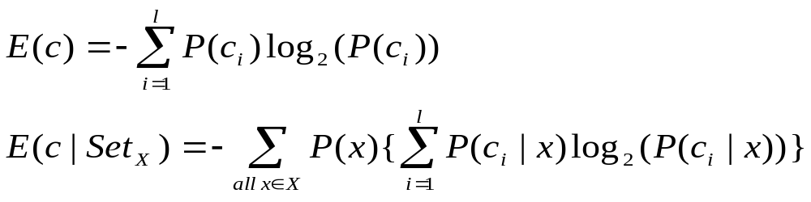
Feature Selection
OLM based on Mutual Information - a measure that uses entropy as a criterion for feature selection.
For discrete features:
Entropy
Conditional Entropy
Set_{X} – subset, c_{i} – class, l – number of classes
Criterion: J_{feature}(Set_{X}) = E(c) – E(c|Set_{X})
if the value of criterion is close to zero than c and x are independent (knowledge of x does NOT improve class prediction)
© 2007 Cios / Pedrycz / Swiniarski / Kurgan

Slide 18
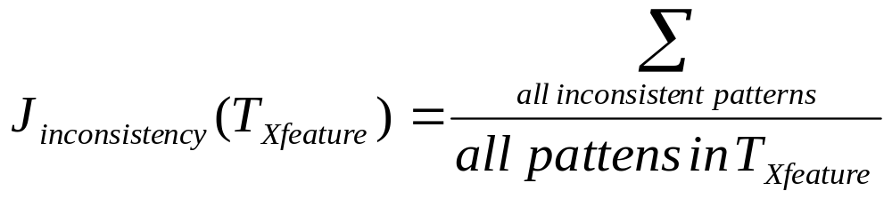
Feature Selection
OLM based on Inconsistency Count – a measure of inconsistency
(patterns initially different become identical and can belong to two or more different classes)
Inconsistency Rate criterion:
X_{feature} – given subset of features
T_{xfeature} – data set that uses only x_{feature}
User decides on the inconsistency count (threshold) for choosing subset X_{feature} (need to choose the threshold that also gives good generalization)
© 2007 Cios / Pedrycz / Swiniarski / Kurgan

Slide 19
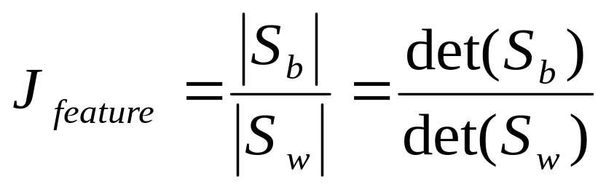
Feature Selection
OLM based on Interclass Separability – a feature subset should have a small within-class scatter and a large between-class scatter.
Recall Fisher’s LT Class Separability criterion:
S_{b} – between-class scatter matrix
S_{w} – within-class scatter matrix
if J_{feature} is high enough (above some heuristic threshold) then subset is good
© 2007 Cios / Pedrycz / Swiniarski / Kurgan

Slide 20
Feature Selection
CLOSED-LOOP METHODS (CLM)
Selection of a feature subset is based on the ultimate goal:
the best performance of a processing algorithm.
Using a feedback mechanism is highly advantageous.
Predictor of performance/evaluator of a feature subset is often:
- the same as for the given classifier, such as NN, k-nearest neighbors
- computationally expensive - we thus look for sub-optimal subsets
Criterion: Count the number of misclassified patterns for a specified feature subset
© 2007 Cios / Pedrycz / Swiniarski / Kurgan

Slide 21
Feature Selection
Goal of SEARCH METHODS:
search only through a subset of all possible feature subsets.
Only sub-optimal subset of features is obtained but at a (much) lower cost.
REASON
The number of possible feature subsets is 2^{n}
  where n – original number of features;
  search for that number of subsets is computationally very expensive.
  Optimal feature selection is NP-hard thus we need to use sub-optimal feature selection methods.
© 2007 Cios / Pedrycz / Swiniarski / Kurgan

Slide 22
Feature Selection
SEARCH METHODS
Exhaustive search
Branch and Bound
Individual Feature Ranking
Sequential Forward and Backward FS
Stepwise Forward Search
Stepwise Backward Search
Probabilistic FS
© 2007 Cios / Pedrycz / Swiniarski / Kurgan

Slide 23
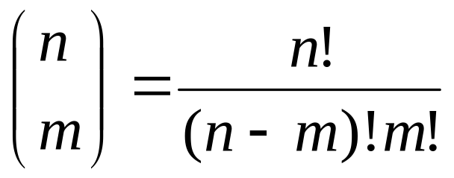
Feature Selection
Goal of SEARCH METHODS
Optimal (sub-optimal) selection of m features out of n features.
Total number of possible subsets:
To evaluate the set of selected features we use this feature selection criterion:
J_{feature} (X_{feature})
which is a function of m = n-d features
(where d – number of discarded features).
We alternatively search for “optimal” set of discarded features.
© 2007 Cios / Pedrycz / Swiniarski / Kurgan

Slide 24
Feature Selection
SEARCH METHODS
Monotonicity of the feature selection criterion:
The best feature set is found by deleting d indices
z₁, z₂,…,z_{d}
and assume that the maximal performance criterion value for this subset is
J_{feature}(z₁, z₂,…,z_{d})=β
β-current threshold in the B&B tree
© 2007 Cios / Pedrycz / Swiniarski / Kurgan

Slide 25
Feature Selection
SEARCH METHODS
Monotonicity of the feature selection criterion.
New feature subset is found by deleting r≤d indices:
z₁, z₂,…,z_{r}
If
J_{feature}(z₁, z₂,…,z_{r}) ≤ β
then from the monotonicity property we know that
J_{feature}(z₁, z₂,…,z_{r}, z_{r+1},…,z_{d}) ≤ J_{feature}(z₁, z₂,…,z_{r}) ≤ β
this new feature subset and its successors CANNOT be optimal
© 2007 Cios / Pedrycz / Swiniarski / Kurgan

Slide 26
Feature Selection
Branch and Bound Algorithm
Assumes that feature selection criterion is monotonic
Uses a search tree, with the root including all n features
For each tree level, a limited number of sub-trees is generated by deleting one feature from the set of features from the ancestor node
(z_{j} – index of a discarded feature; each node has a set of features identified by sequence of already discarded features, starting at the root)
The largest value of feature index z_{j} on the j^{th} level is (m+j)
B&B creates tree with all possible combinations of m-element subsets from the n-element set, but searches only some of them
© 2007 Cios / Pedrycz / Swiniarski / Kurgan

Slide 27
Feature Selection
Branch and Bound
Idea – feature selection criterion is evaluated at each node of a search tree
IF the value of the criterion is less than threshold β
(relevant to the most recent best subset) at a given node
THEN all its successors will also have a value of the selection criterion less than β
THUS the corresponding sub-tree can be deleted from the search
© 2007 Cios / Pedrycz / Swiniarski / Kurgan

Slide 28
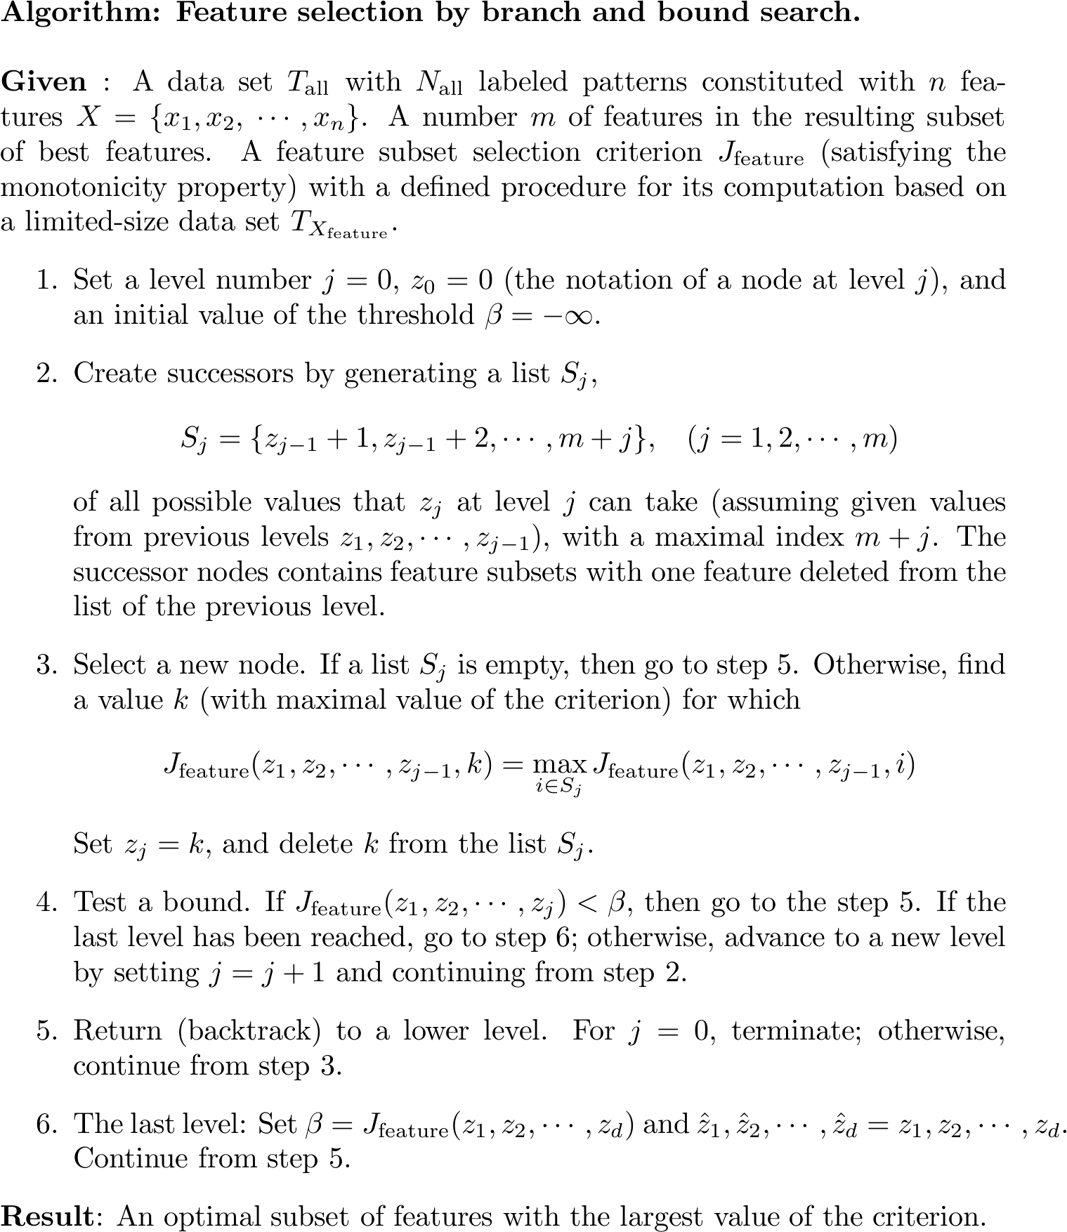
© 2007 Cios / Pedrycz / Swiniarski / Kurgan

Slide 29
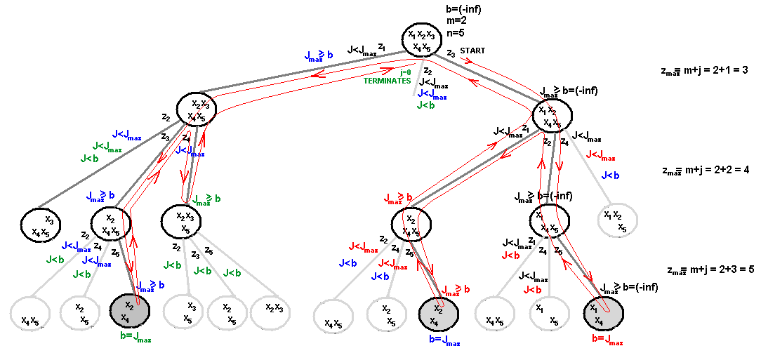
Feature Selection
B&B example: Selection of m=2 feature subset out of n=5 features; feature selection criterion is monotonic
© 2007 Cios / Pedrycz / Swiniarski / Kurgan

Slide 30
Feature Selection
Individual Feature Ranking
Idea – evaluate predictive power of an individual feature. Then order them, and choose the first m features.
Evaluation of features can be done using closed-loop or open-loop criteria
Assumption:
All features are independent (uncorrelated) and the final criterion is a sum, or product, of the criteria used for each feature independently.
© 2007 Cios / Pedrycz / Swiniarski / Kurgan

Slide 31
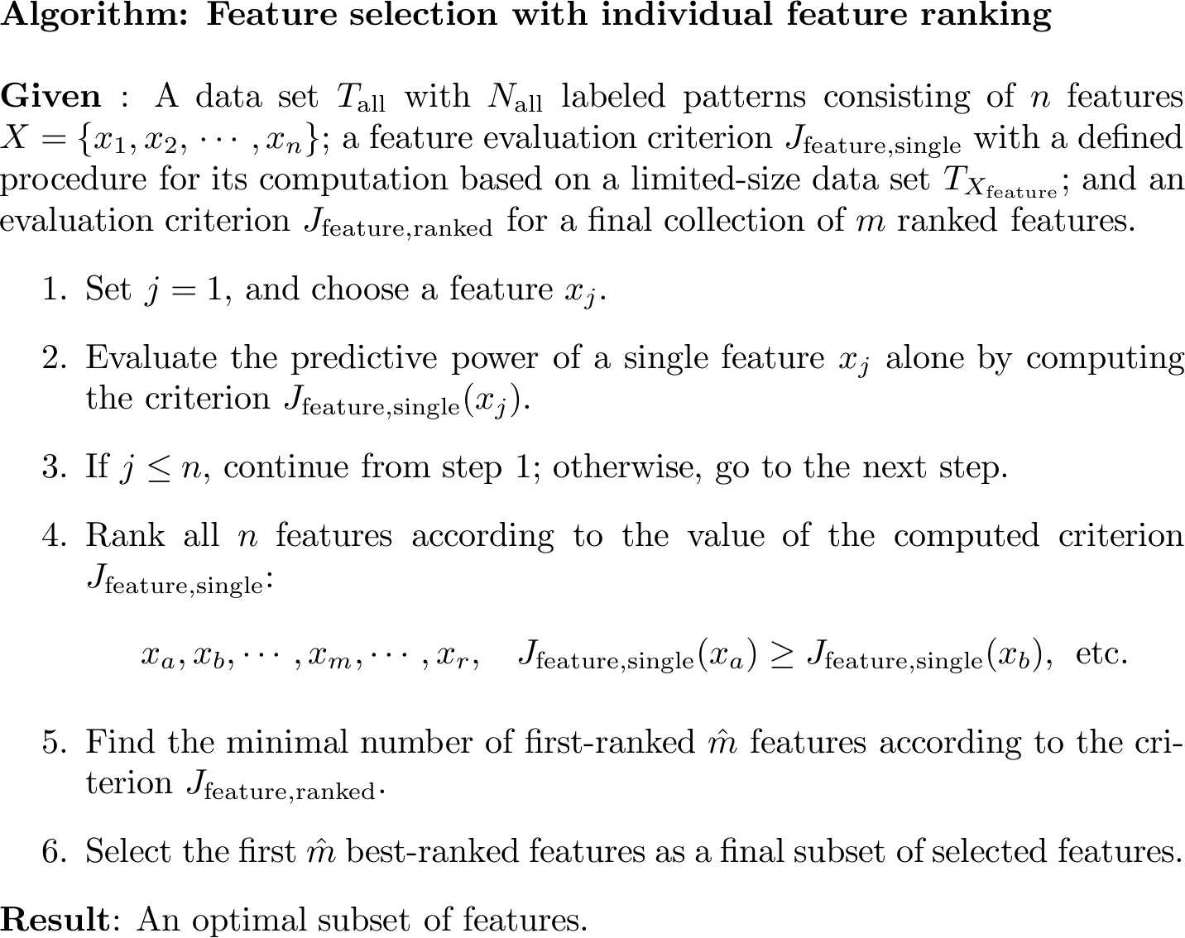
© 2007 Cios / Pedrycz / Swiniarski / Kurgan

Slide 32
Feature Selection
Sequential Forward Feature Selection
Sub-optimal (we do not examine all feature subsets)
Highly reduced computational cost
In each step of the search one “best” feature is added to the sub-optimal feature subset
During the first iteration individual feature selection criterion is evaluated and feature x* is selected
During the second iteration feature selection criterion is evaluated for all pairs (x*,x_{n}) and best 2-feature subset is selected, etc.
© 2007 Cios / Pedrycz / Swiniarski / Kurgan

Slide 33
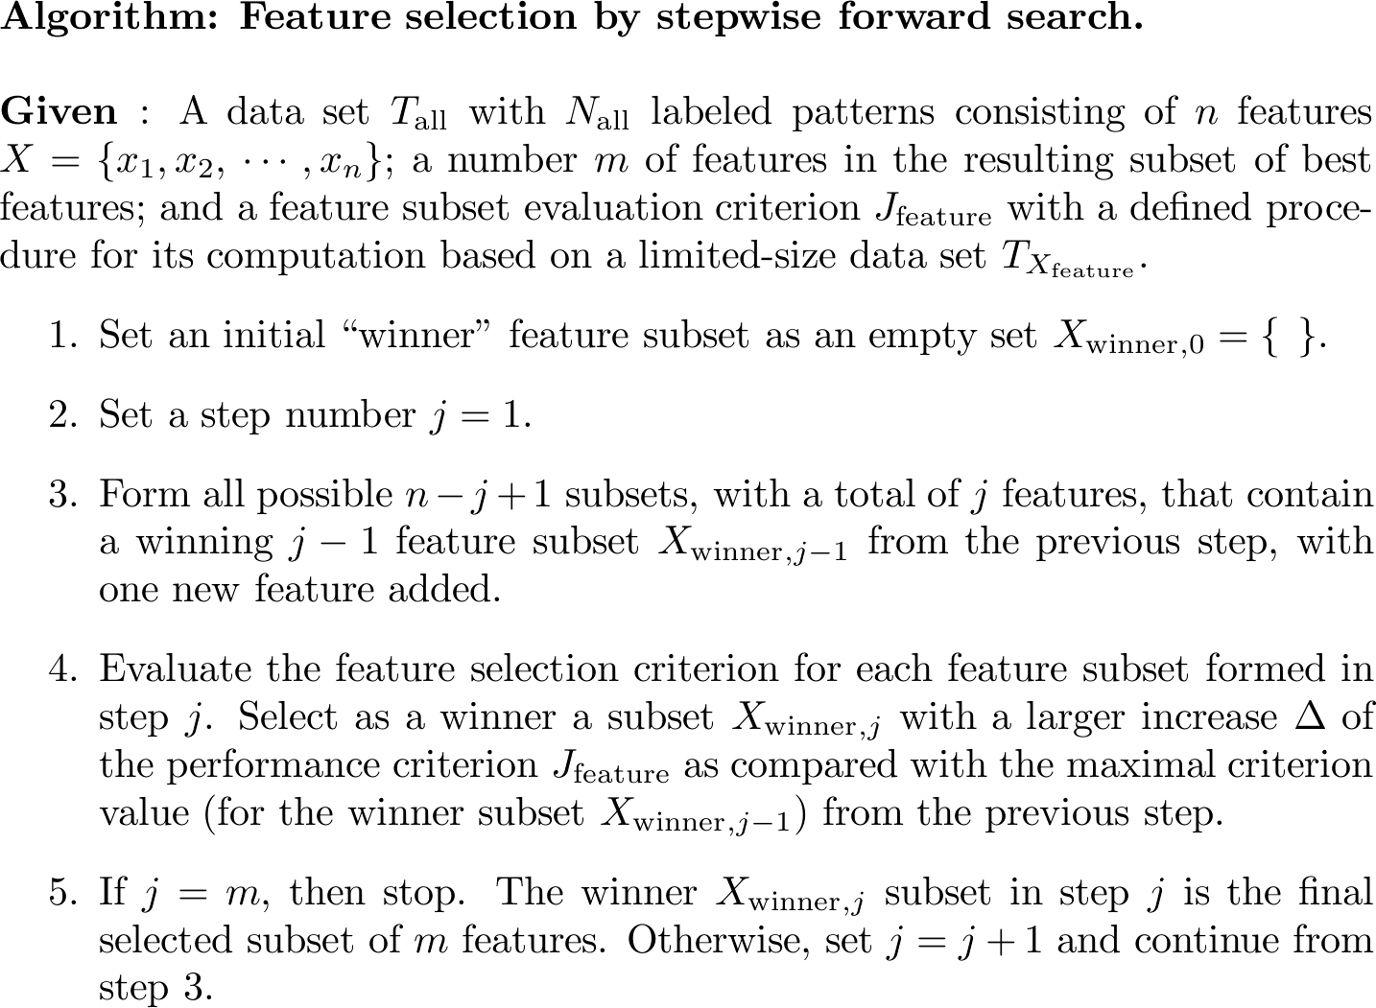
© 2007 Cios / Pedrycz / Swiniarski / Kurgan

Slide 34
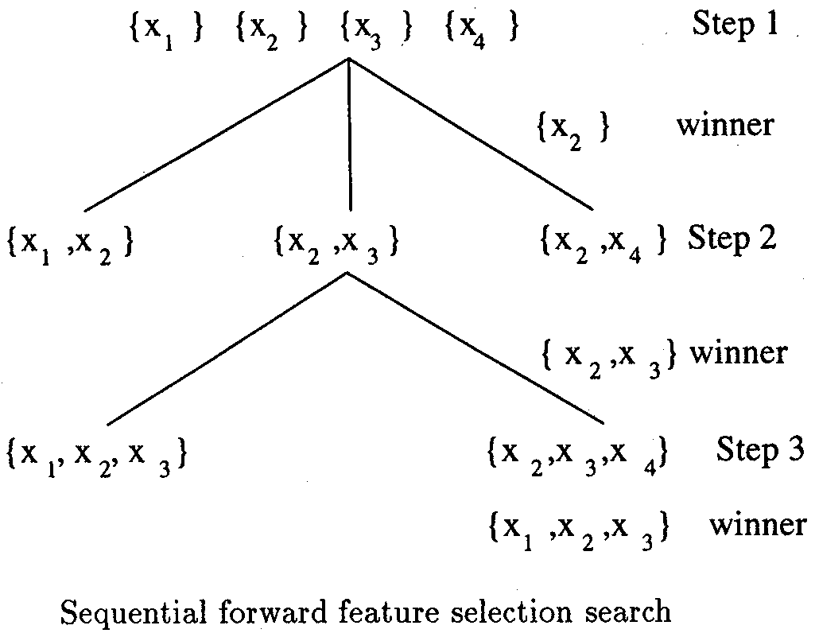
Feature Selection
Sequential Forward Feature Selection
Example:
selection of m=3
out of n=4 features
© 2007 Cios / Pedrycz / Swiniarski / Kurgan

Slide 35
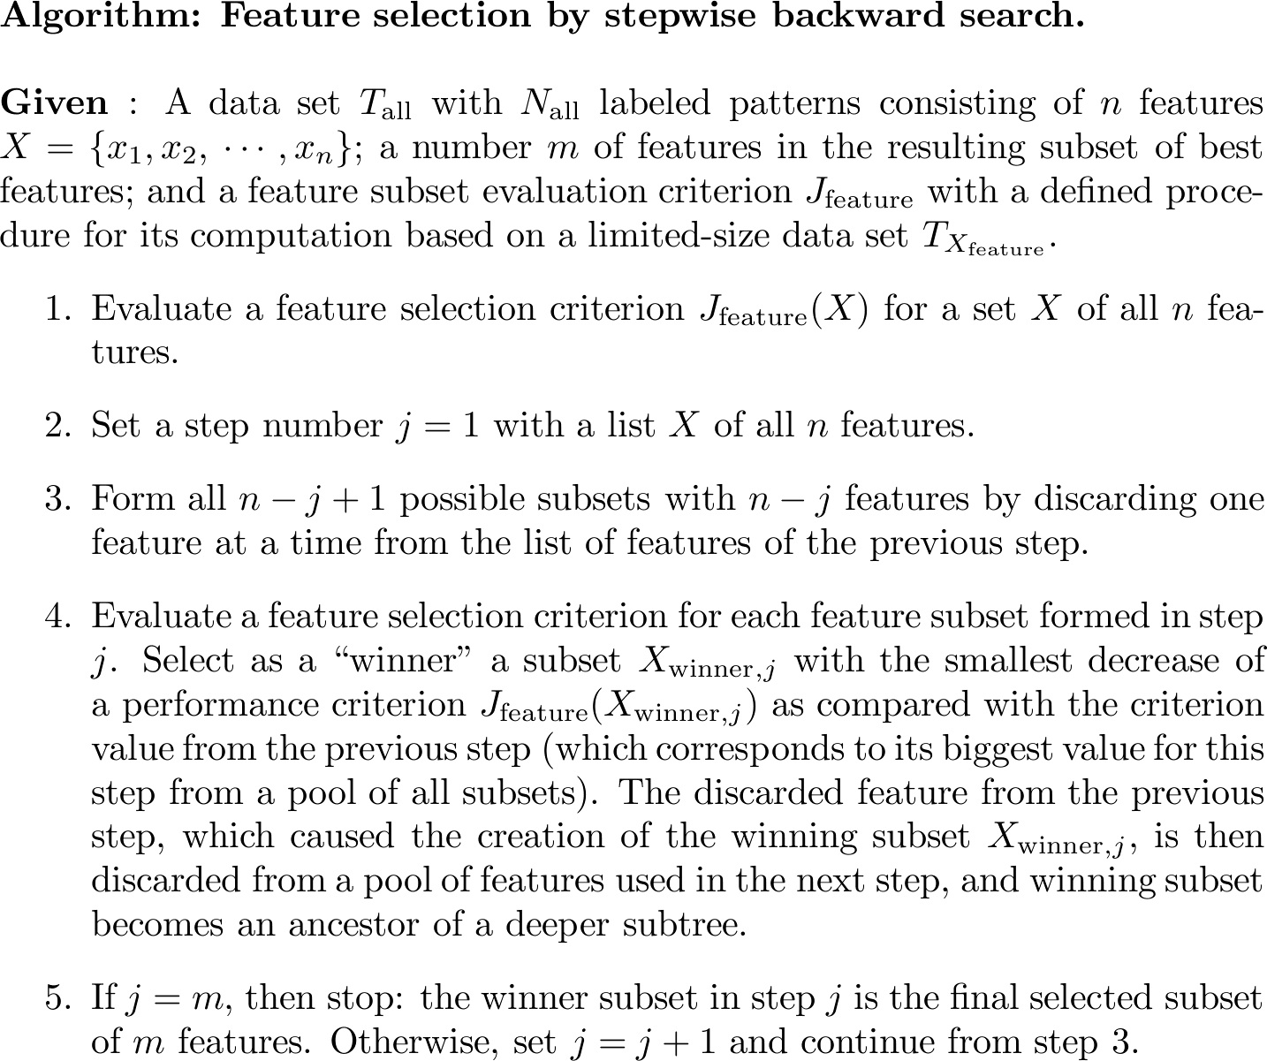
© 2007 Cios / Pedrycz / Swiniarski / Kurgan

Slide 36
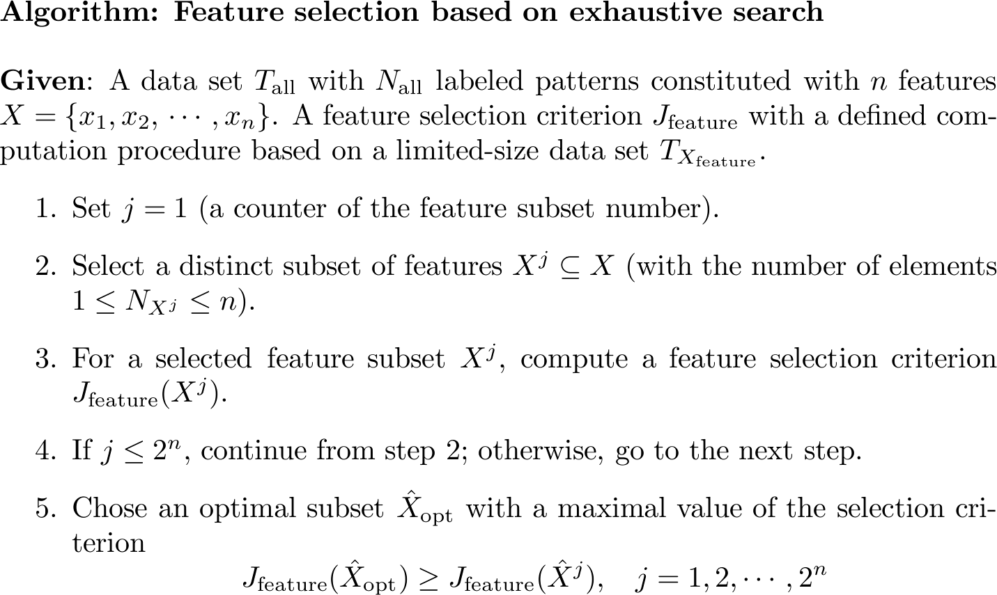
© 2007 Cios / Pedrycz / Swiniarski / Kurgan

Slide 37
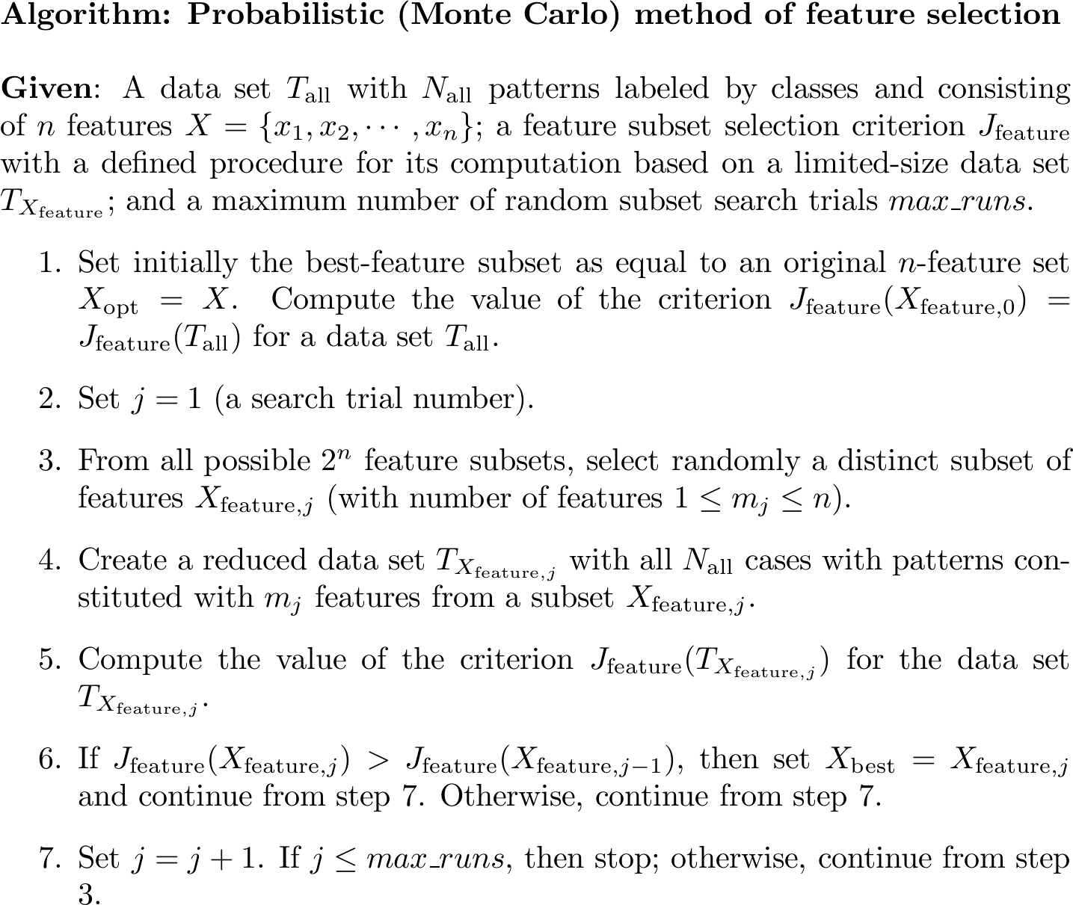
© 2007 Cios / Pedrycz / Swiniarski / Kurgan

Slide 38
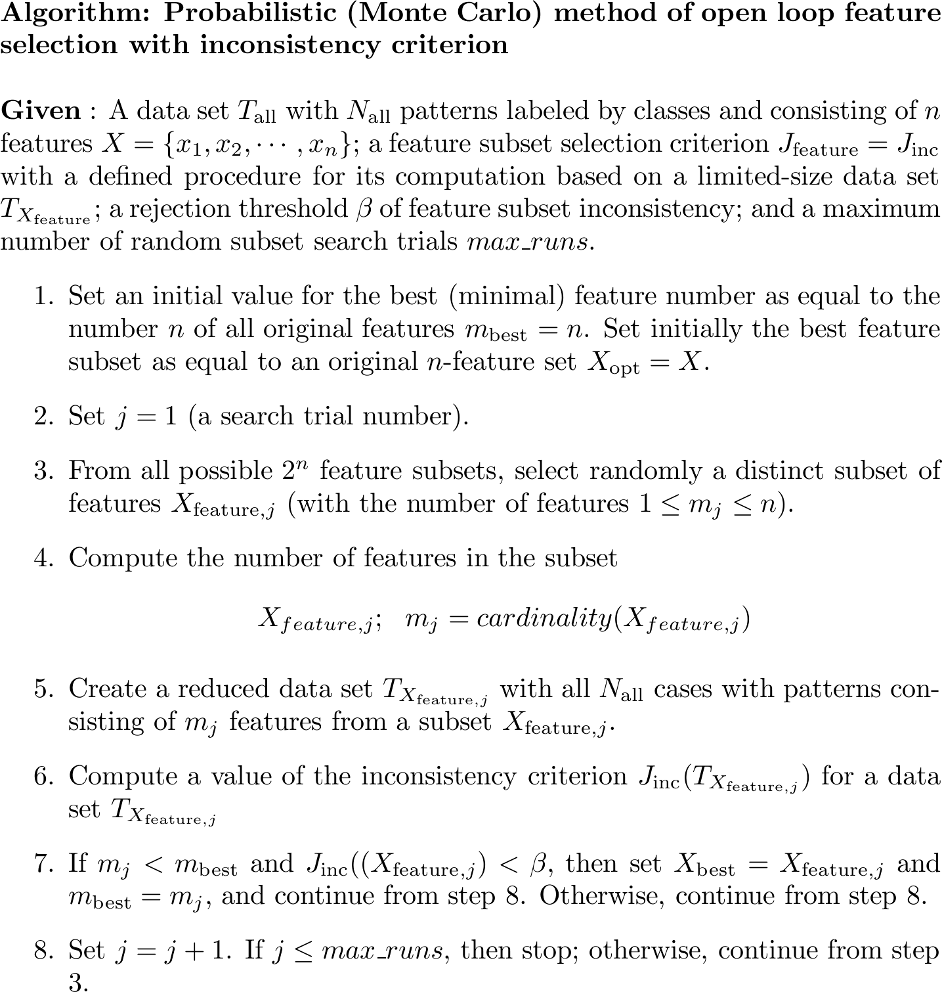
© 2007 Cios / Pedrycz / Swiniarski / Kurgan

Slide 39
Feature Selection
Other Methods
SOM (Kohonen’s neural network)
Feature selection via Fuzzy C-Means clustering
Feature selection via inductive machine learning
…
© 2007 Cios / Pedrycz / Swiniarski / Kurgan

Slide 40
References
Cios, K.J., Pedrycz, W., and Swiniarski, R. 1998. Data Mining Methods for Knowledge Discovery. Kluwer
Duda, R.O., Hart, P.E., and Stork, D.G. 2001. Pattern Classification. Wiley
Han, J., and Kamber, M. 2006. Data Mining: Concepts and Techniques. Morgan Kaufmann
Kecman, V. 2001. Learning and Soft Computing. MIT Press
© 2007 Cios / Pedrycz / Swiniarski / Kurgan

